Slide 1
From School to Work: what is the connection?

Slide 2
Variables Profiling the Occupation
JOB Characteristics
INCOME
SELF-
GOVERNANCE
TENURE
CAREER
INTEREST
RISK
STATUS
PERKS
HEALTH
BENEFITS
ON-THE-JOB
LEARNING
Who controls which variables?

Slide 3
Variables Profiling the School
SCHOOLING
LEVEL
Who controls which variables?
CURRICULUM
GOVERNANCE
FUNDING
TEACHER SKILL
CERTIFICATES ISSUED
CLIMATE
TEACHER
KNOWLEDGE
STATUS
SIZE
ENTRANCE
REQUIREMENTS

Slide 4
Variables Profiling the Learner
PERSON
Certificates
Diplomas
Degrees
Memberships
Family Status
Peer Status
Friendships
“Connections”
Attitudes
Tastes
Skills
Dispositions
Knowledge
Who controls which variables?
Memories

Slide 5
How Do School And Learner Variables Interact?
SCHOOLING
PERSON
Level
Diplomas
Curriculum
Certificates
Degrees
Governance
Memberships
Teacher Skill
Family Status
*
Peer Status
Certificates issued
Friendships
Climate
“Connections”
Teacher
Attitudes
Knowledge
Tastes
Skills
Location
Dispositions
Status
Knowledge
Size
Memories
Entrance
Requirements
*arrows represent hypothesized causal connections

Slide 6
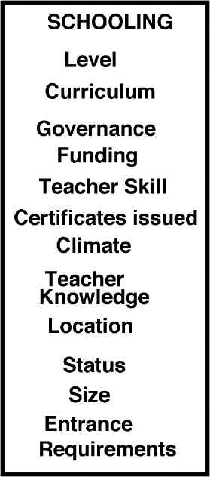
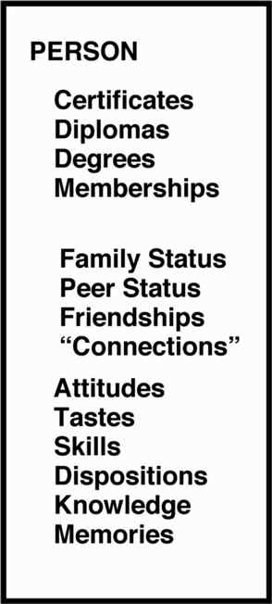
What Other Factors Intrude?
Other
Factors
GOVERNMENT
POLICIES
WEATHER
“SOCIAL MEMORY”
LOCAL TAX STRUCTURE
COMMUNITY HEALTH
MYTHOS
EXTERNAL
MARKETS
GEOGRAPHY
TECHNOLOGY
Who controls them?

Slide 7
Is This the Whole Picture?
External
Factors
EDUCATOR’S
DOMAIN OF CONTROL
School
Person
Occupation
NOT YET!

Slide 8
What about the Job Market?
External
Factors
EDUCATOR’S
DOMAIN OF CONTROL
School
Job
Market
Person
Occupation
What is it reasonable to hold educators accountable for?

Slide 9
Variables Profiling the Job Market
JOB MARKET
Employment Offers
Skill
Requirements
Social
Requirements
Geographical
Access
Certification
Requirements
Permanence
Who controls what?

Slide 10
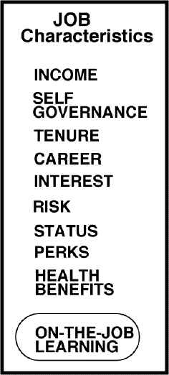
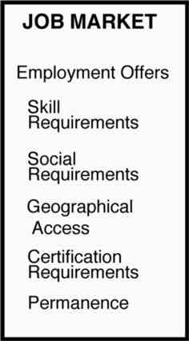
The Complete Model
COMPETITION & INTERACTION
JOB MARKET m+...
PERSON
n +...
JOB MARKET m+1
PERSON
n +1

